Slide 1

Presented By | Shrestha Jaiswal
Phone Number | 7007226481
Email ID | Shresthajaiswal1705@gmail.com
Campus | UPES-Dehradun
Degree | B.Tech
Branch | CSE
Domicile Place | Jhansi, Uttar Pradesh
October 27,2023

Slide 2
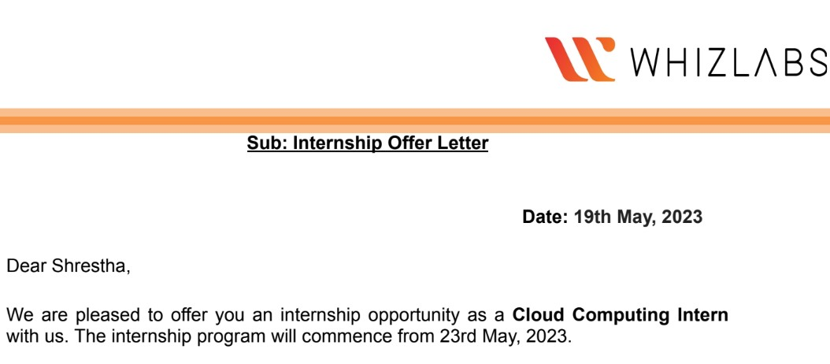
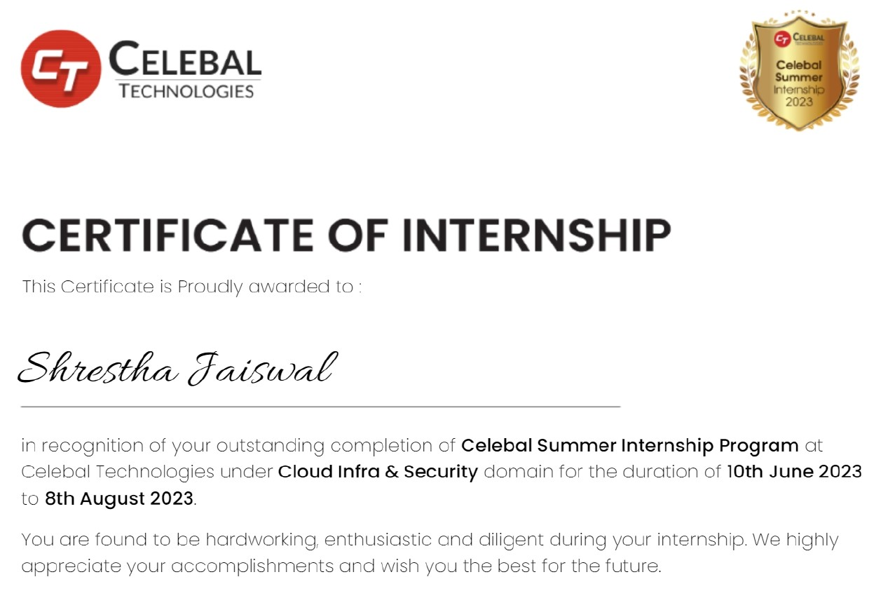
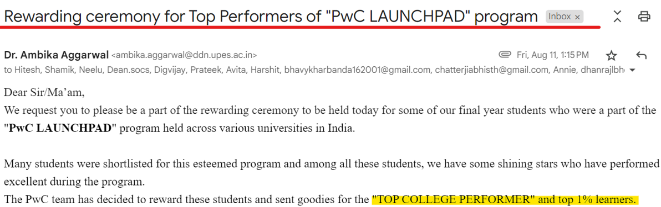
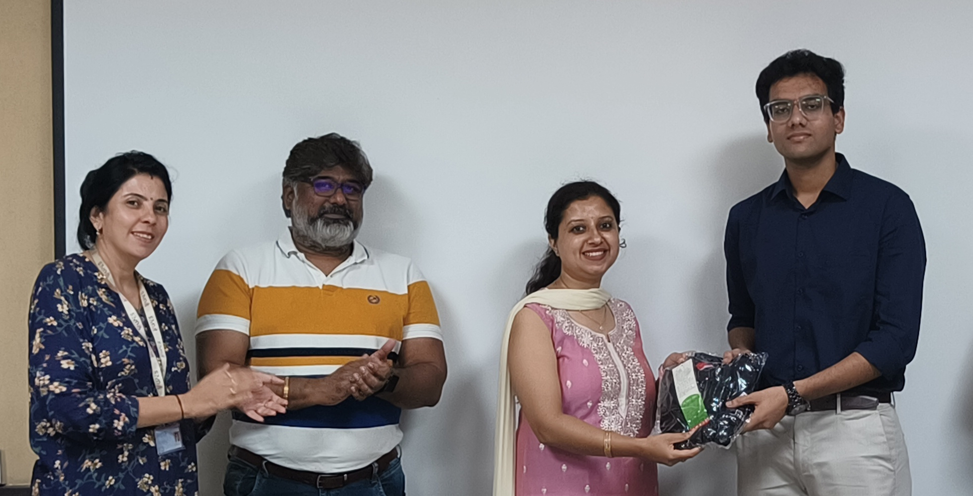
Accomplishments
Securing Internships (Offcampus/Oncampus)
Top 1% learners in PWC LAUNCHPAD
Maruti Presentation

Slide 3

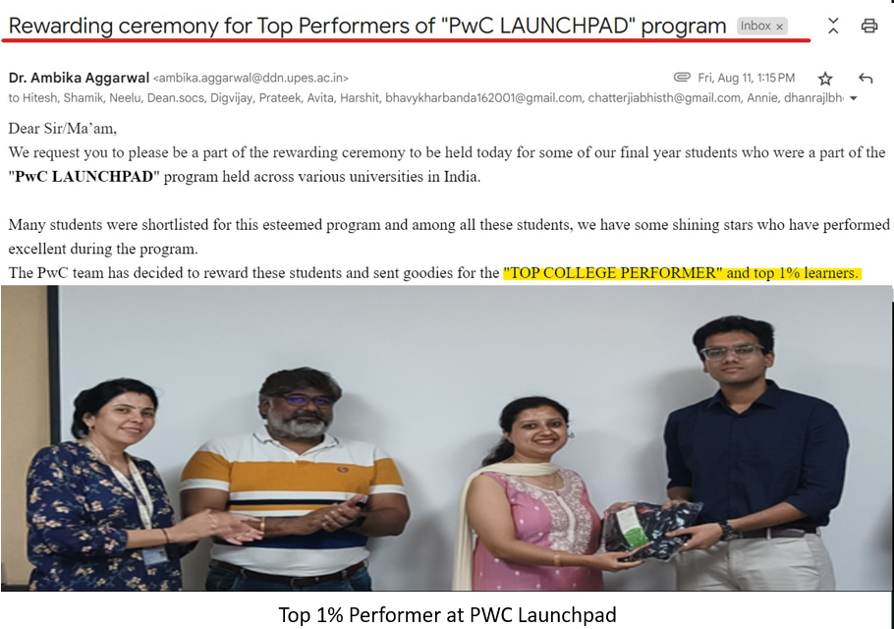

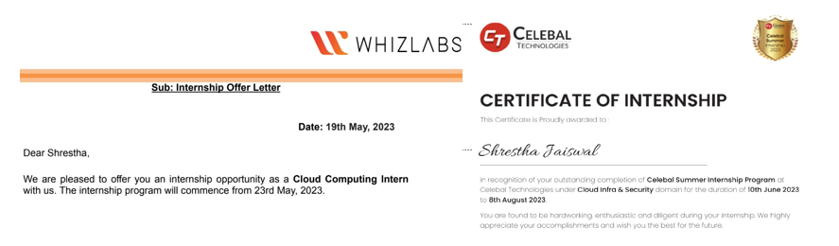
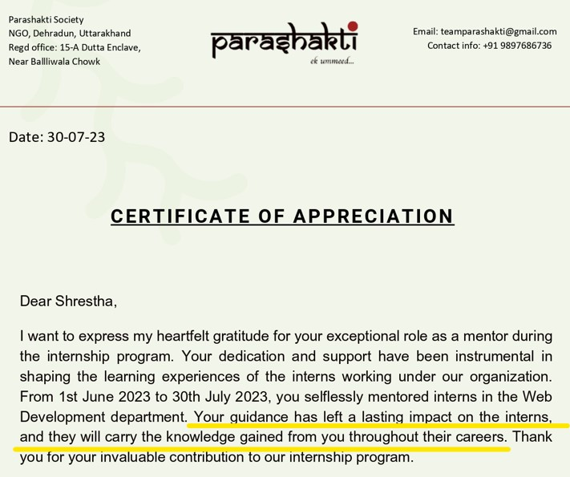
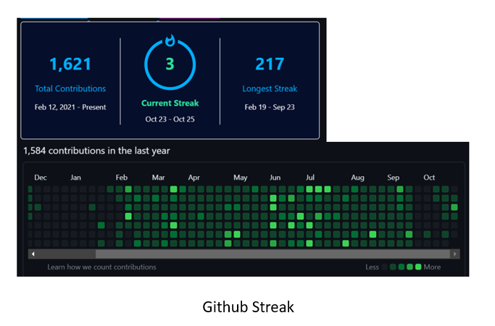
How am I different from others?
Maruti Presentation

